Slide 1
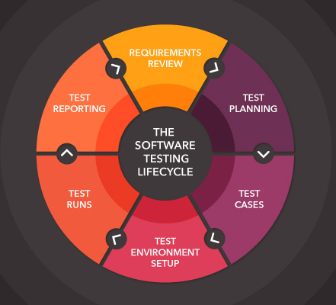
Trailseek
Manual Testing at Front End
Notes:
NOTE:
To change the image on this slide, select the picture and delete it. Then click the Pictures icon in the placeholder to insert your own image.

Slide 2
Manual Testing Objectives
A. How well TrailSeek works.
B. To identify the correctness, completeness, quality and security of developed application.
C. All test cases will be executed without any automation tool.
D. Testing all key checkpoints in overall process to determine whether objectives are being met.
For Example: Fulfill of user requirements.

Slide 3
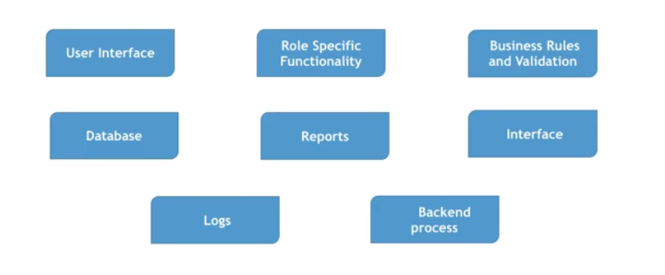
Components of Application (TrailSeek)

Slide 4
Characteristics of Application ( Application is being Tested on following Characteristics )
Performance
Criticality
Global Usage
Compliance
Sensitive Data Handling
UI Criticality
End User Categories

Slide 5
User Expectation from Application
Correct Output: Application must give correct output.
Response Time: Effective response time is expected.
Performed Specific task: Application will perform the given specific task.
User Friendly: TrailSeek will follow all user-friendly guidelines.

Slide 6
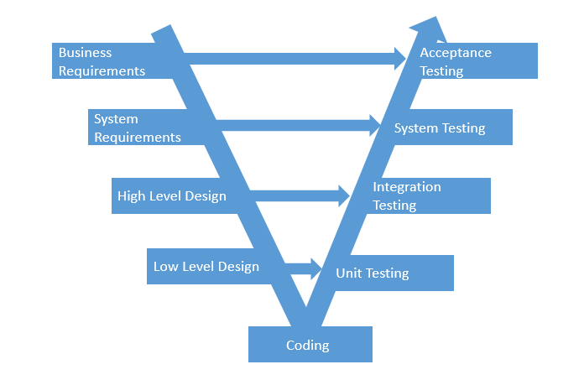
Manual Testing Strategies at Front-End
Role of Tester: Find defects ASAP, Report the defects and take necessary actions against defects.
V-Model:

Slide 7
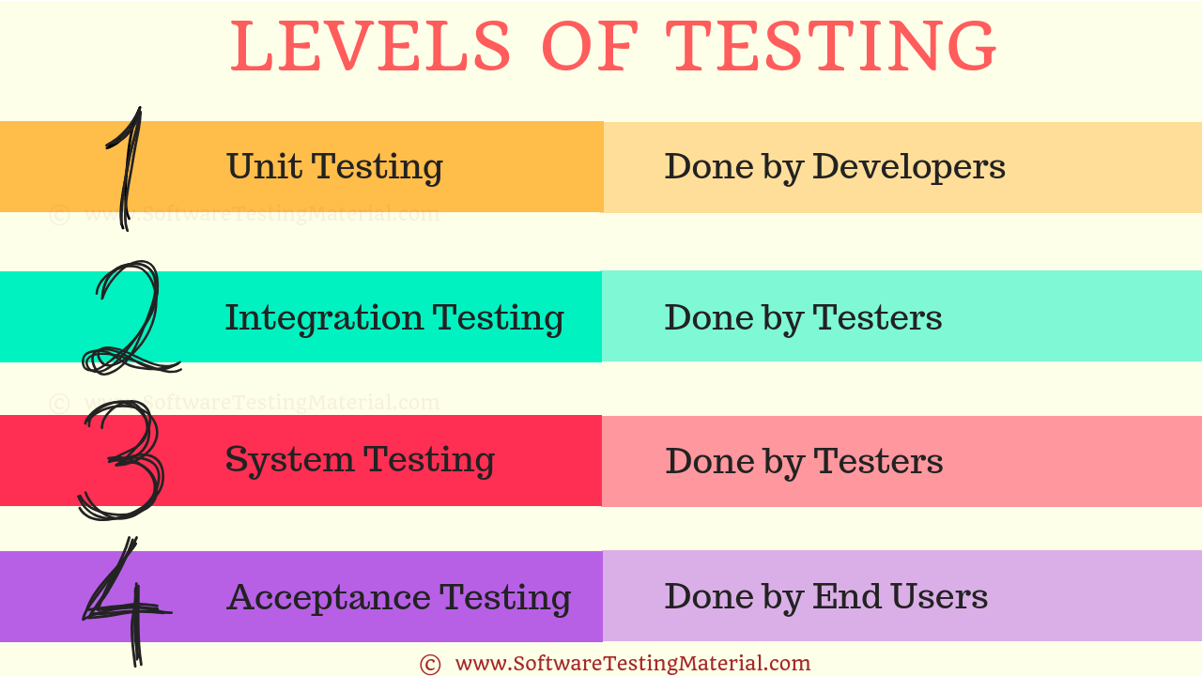
Verification process and Validation process
Verification: Are we building the product, right ?
Walkthrough : Informal process
Explanation and observations.
2. Review : formal process (Team observation, review and report submitted.)
Validation process: Process of evaluating the application during or end of development process.
(Levels of Testing)

Slide 8
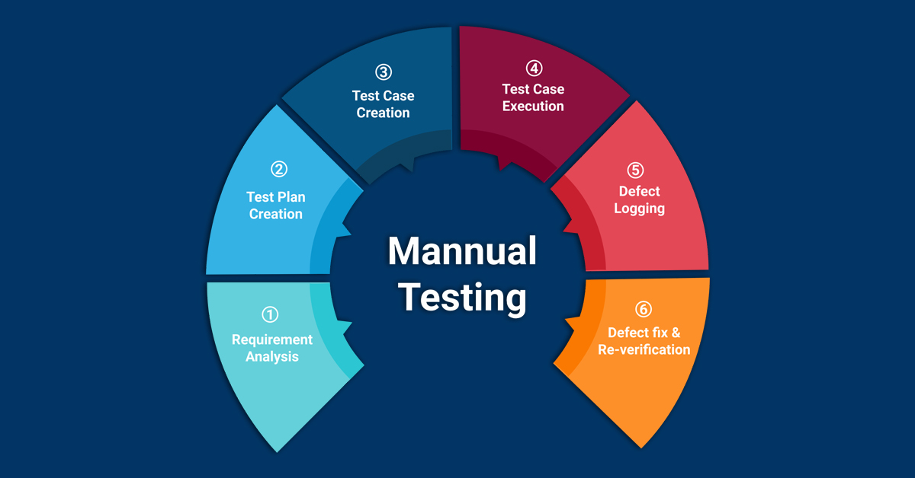
User Expectation from Application

Slide 9
Test Plan
A dynamic document. The success of a testing project depends upon a well-written Test Plan document that is always current. Test Plan is like a blueprint of how the testing activity is going to take place in a project.
Given below are a few pointers on a Test Plan of TrailSeek:
1) Test Plan is a document that acts as a point of reference and only based on that testing is carried out within the team.
2) It is also a document that we share with the team, Project Manager, Dev team and scrum master. This helps to enhance the level of transparency of the team’s work to the external teams.
3) It is documented based on the inputs from the team members.
4) Test Planning is typically allocated with 1/3rd of the time that takes for the entire project engagement. The other 1/3rd is for Test Designing and the rest is for Test Execution.
5) This plan is not static and is updated on an on-demand basis.
6) The more detailed and comprehensive the plan is, the more successful will be the testing activity.

Slide 10
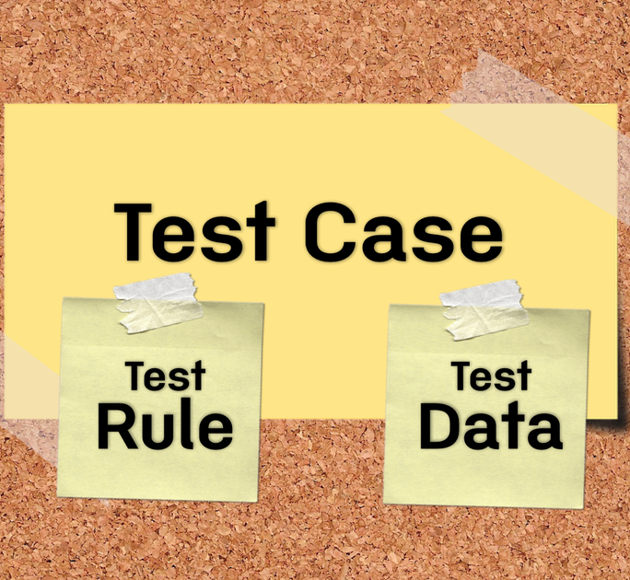
A TEST CASE is a set of actions executed to verify a particular feature or functionality of software application. A Test Case contains test steps, test data, precondition, postcondition developed for specific test scenario to verify any requirement. The test case includes specific variables or conditions, using which we will compare expected and actual results to determine whether a software product is functioning as per the requirements of the Application. Test cases will be focused on Test Scenario Vs Test Case Test scenarios are rather vague and cover a wide range of possibilities. Testing is all about being very specific. For a Test Scenario: Check Login Functionality there many possible test cases are: Test Case 1: Check results on entering valid User Id & Password Test Case 2: Check results on entering Invalid User ID & Password Test Case 3: Check response when a User ID is Empty & Login Button is pressed, and many more.

Slide 11
Test execution
Test execution includes the process of executing the code and comparing the expected and actual results.
Following factors are to be considered for a test execution process:
Based on a risk, select a subset of test suite to be executed for this cycle.
Assign the test cases in each test suite to testers for execution.
Execute tests, report bugs, and capture test status continuously.
Resolve blocking issues as they arise.
Report status, adjust assignments, and reconsider plans and priorities daily.
Report test cycle findings and status.

Slide 12
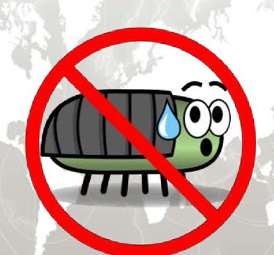
Defect logging, a process of finding defects in the application under test or product by testing or recording feedback from team and making new versions of the product that fix the defects or feedback.
Defect tracking is an important process in software engineering as Complex and business critical systems have hundreds of defects. One of the challenging factors is Managing, evaluating and prioritizing these defects. The number of defects gets multiplied over a period of time and to effectively manage them, defect tracking system is used to make the job easier.
Examples - IBM Rational Quality Manager
Defect Tracking Parameters
Defects are tracked based on various parameters such as:
1. Defect Id
2. Priority
3. Severity
4. Created by
5. Created Date
6. Assigned to
7. Resolved Date
8. Resolved By
9. Status

Slide 13
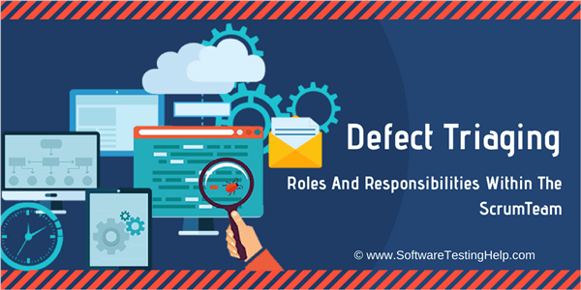
Defect Fix & Re-Verification of TrailSeek
When the developer makes necessary code changes and verifies the changes then he/she can make bug status as ‘Fixed’ and the bug is passed to testing person. At this stage the tester do the retesting of the changed code which developer has given to him to check whether the defect got fixed or not.

